Slide 1

TRAFFIC ACCIDENT SEVERITY PREDICTION – Presentation
Created by Andy Sin

Slide 2
Introduction
Drivers and insurers alike are keen to understand what is the probability and potential severity of accidents occurring on a given journey and under certain observable conditions.
The analysis presented here will help users
in determining the appetite for undertaking particular journeys; or
assist insurers in determining the premium level which should be applied to insurance.

Slide 3
The Analysis

Slide 4
The Data
The dataset is based on publicly available collision data for the Seattle and as captured by Seattle Police Department and includes dataset contains collision data from 2004 to present.
For the purpose of this evaluation, the dataset was consolidated down to focus on the following attributes which forms the main element of our modelling:
Severity Descriptions
Incident Date
Incident Time
Weather Conditions
Light Conditions
Road Conditions

Slide 5
Methodology
The overall exercise was broken down into two distinct parts
Part 1
Explored the distribution of collision across the selected key attributes which have been selected. The intent of this was to help in diagnosing the broad trends in the data, if any.
Part 2
Modelling based on the attributes selected and using that as future predictor in determining if a collision were to occur, whether it will be a Severity 1 or 2.
It is worth noting that as we do not have associated data on the total journeys which were made, the model will not be able to predict the probability of a collision happening in the first instance.
The Decision Tree Modelling technique was selected

Slide 6
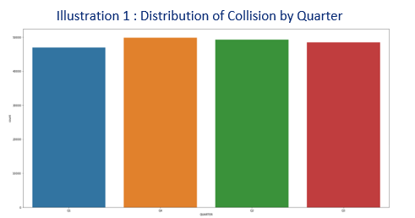
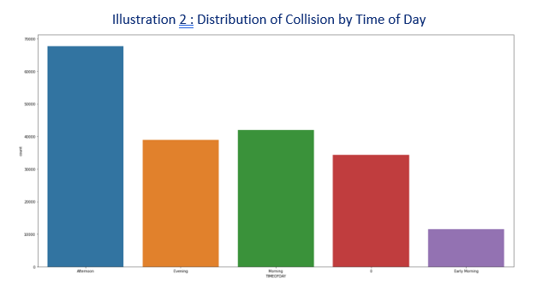
Results Part 1
Key observations:
collision is spread relatively evenly across all quarters although Q1 shows a comparatively lower volume
Assuming that the number of journeys being taken is fairly constant throughout the year, it can be deduced that there are no major seasonal variations in the likelihood of a collision taking place.
Key observations:
materially more accidents taking place in the Afternoon than at any other time during the day
Possibly due to rush hour period with increase traffic on the road combined with higher level of driver fatigue during that time
Additionally, light conditions may be deteriorating at that point

Slide 7
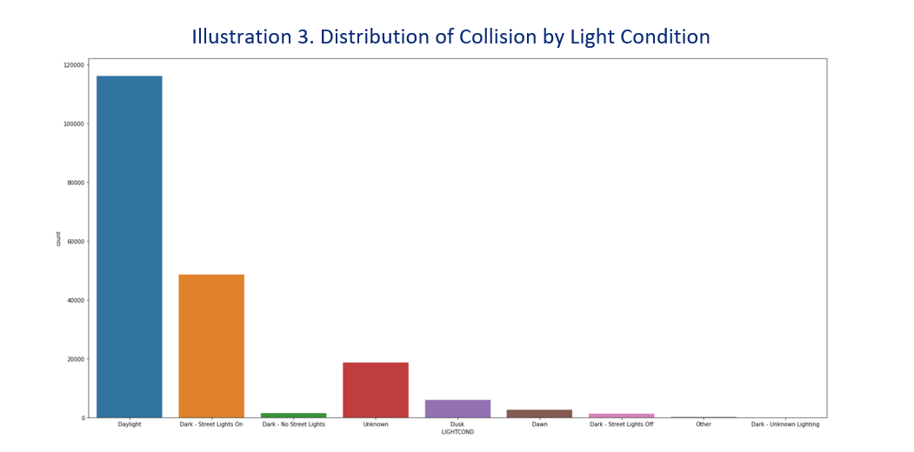
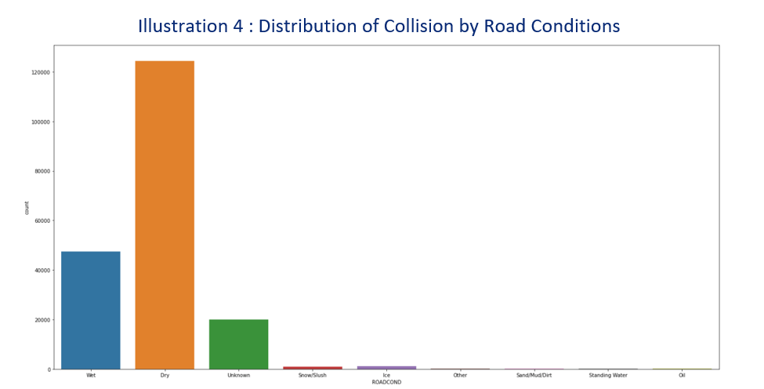
Results Part 1
Key observations:
large majority of the accidents happen during daylight hours
Correlates to the expectation that large majority of journeys undertaken take place during the day
Also in line with higher volume of accidents observed in the Morning and Afternoon periods
Key observations:
Large proportion of collisions do occur in dry conditions
Wet conditions do contribute to significant collisions and may be in line with expectation given Seattle experiences regular participation
Requires broader weather data to further deduce meaningful insight

Slide 8
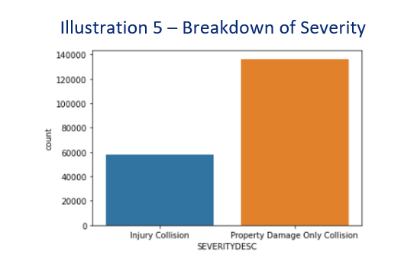
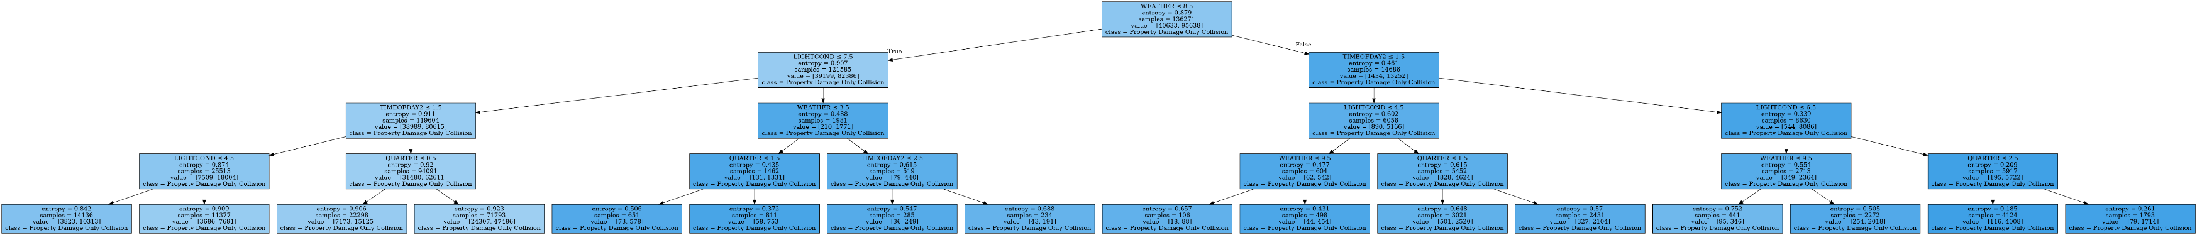
Results Part 2
Context Setting
Greater proportion of collision which are categorised Severity 1 – Property Damage Only Collision.
Expectation therefore that for the large proportion of overall conditions, it is more likely that a collision will be Severity 1 Collision.
Decision Tree aimed to determine if certain conditions may be observed to lead Severity 2 collision to be more probable
Key Observations
Decision Tree built from these in-scope variables - Time of year, Time of Day, Weather Condition and Light Condition.
Severity 1 collision is the likeliest outcome associated with the variables in questions.

Slide 9
Conclusion

Slide 10
Conclusion
Types of Collisions
Good level of initial insight on the distribution of the collisions based on Part 1 analysis
Clearly shown that collisions are not evenly distributed across variables (except Time of Year)
Deduced that more collisions happen under certain conditions
BUT
In the absence of broader underlying journey dataset and road conditions across all journeys, not possible to definitively confirm if certain conditions are more likely to cause collisions for a given journey
Severity of Collisions
No specific conditions which will lead to a Severity 2 collision being more likely to happen than a Severity 1 collision
BUT
Further analysis is merited to explore if other categories of data may yield a different result

